Slide 1


Do increasing concentrations of lime sulphur solution act as stronger honey bee repellents?
Ethan Scott, Daniel Girvitz

Slide 2


Background
8 groups of 100 bees were released into 8 different chambers for two hours.
Each chamber, except one control, contained cells of dry comb with lime sulphur emulsion in sucrose solution.
Seven different concentrations of lime sulphur, labelled A - G, ranged from a concentration of 1/100 to 1/1,562,500, in successive factors of ⅕.
The one control, labelled H, contained no lime sulphur emulsion in the sucrose solution.
The decrease in volume of the solutions in the various cells was measured, in order to determine the potency of the lime sulphur emulsion as a honey bee repellent.

Slide 3
Dataset
An 8x8 Latin square design with coded treatments.
Since we haven’t yet learned about Latin square design, we disregarded that information.
We kept only two variables: “treatment”, which is a factor, and “decrease”, which is discrete numerical.
It appears that decreases in solutions were calculated for 8 random cells of dry comb from each of the 8 groups
n=8 (instances in each treatment)
a=8 (treatments)
N=n*a=8*8=64 (total instances)
Notes:
It appears that - we were unable to find literature on the experiment, so we assume this is the case.

Slide 4
Hypothesis
H0: Equality of treatment means for the decrease in volume of the solutions in the various cells.
Ha: Inequality between at least two treatment means for the decrease in volume of the solutions in the various cells.
Notes:
Simple English: Do increasing concentrations of lime sulphur solution act as stronger honeybee repellents? (H0 - no, Ha - possibly)
Just a note that the null hypothesis tacitly implies that there should be no discernable difference between the control solution - H- and solution A, which could only be true if lime sulphur does not have any repelling properties.

Slide 5
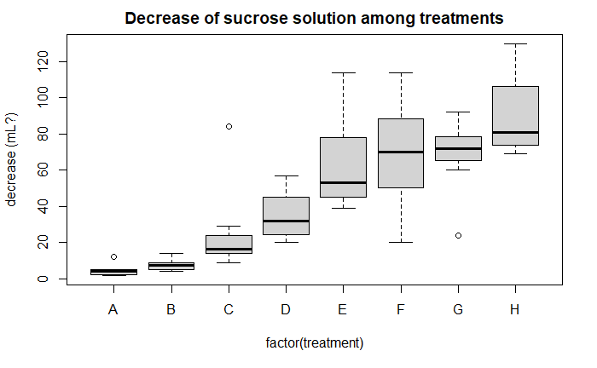
Boxplots

Slide 6
ANOVA Assumptions
Data are i.i.d normally distributed
Homogenity of variance among treatments (in our case, decreases in solutions), which is called homoscedasticity, which is not to be pronounced…
Balanced design
Notes:
As the other groups have shared, we follow typical ANOVA assumptions.

Slide 7
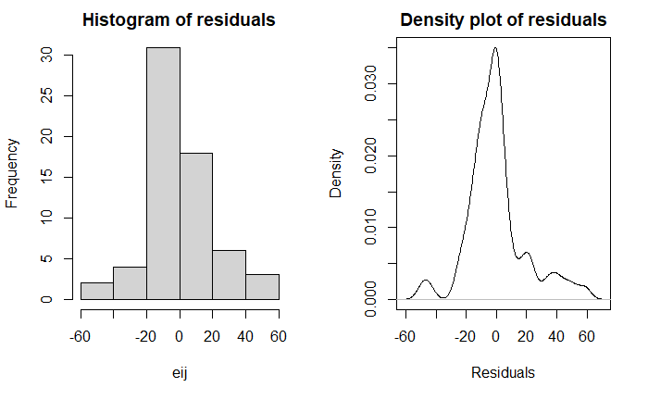
Plots of residuals
Uh oh…
Notes:
Distribution of residuals appears to satisfy the normality assumption, although there is a minor right skew.

Slide 8
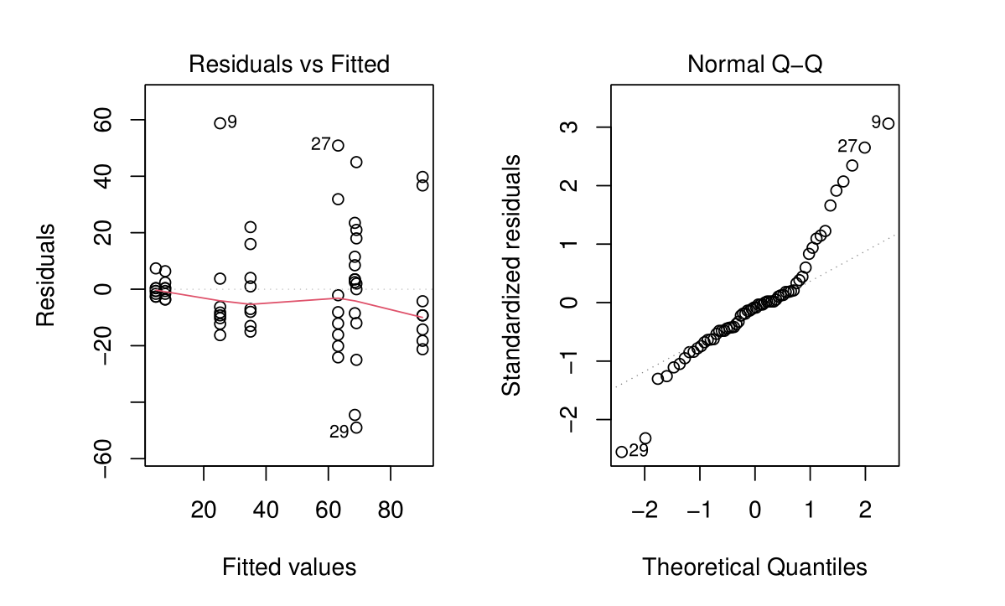
Diagnostic plots
What’s up with this upward curvature?
Unequal variance?
Notes:
Analysis of diagnostic plots:
1. Residuals vs Fitted: Overall, the linear is pretty straight, but some treatment levels see less variance, and others have impactful outliers.
2. Normal Q-Q: The diagonal line does not describe the points very well, which is a possible violation of the normality assumption.
In light of this, we would like to perform some formal testing.

Slide 9
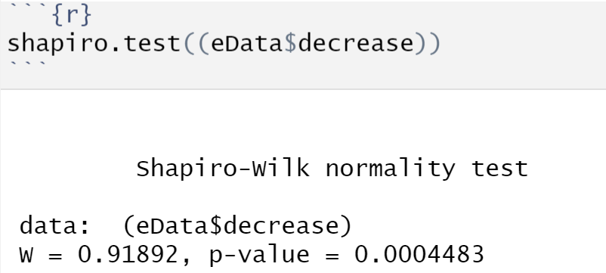
Shapiro-Wilk test
Yikes…
Notes:
But formally, we must reject the normality assumption at a significance level of 0.05.

Slide 10
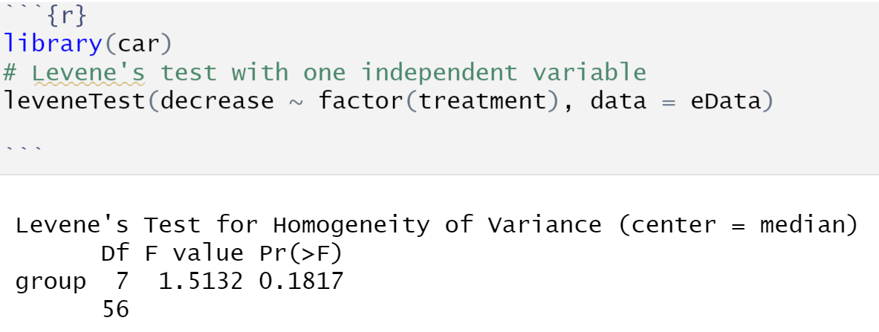
Modified Levene’s Test
FTR equality of variance
Notes:
Variance appears to be fine.

Slide 11
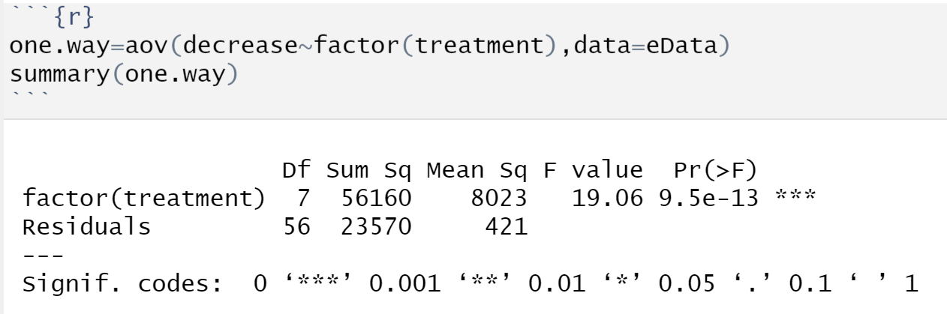
Single-factor ANOVA
Ethan begins here.
FTR equality of treatment means
Notes:
From our p-value in the ANOVA table we can see that it is less than our alpha of 0.05 and therefore we have a difference in treatment means.

Slide 12
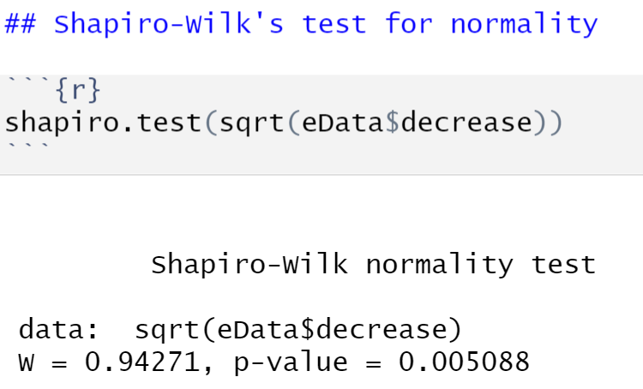
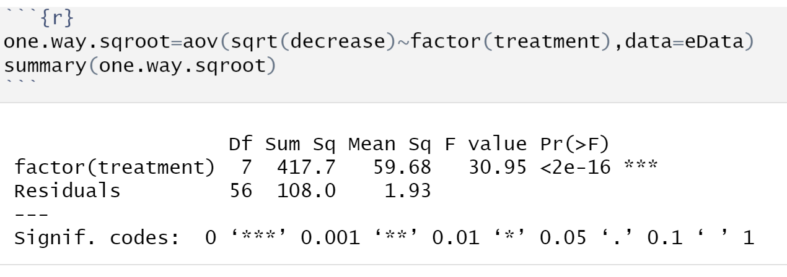
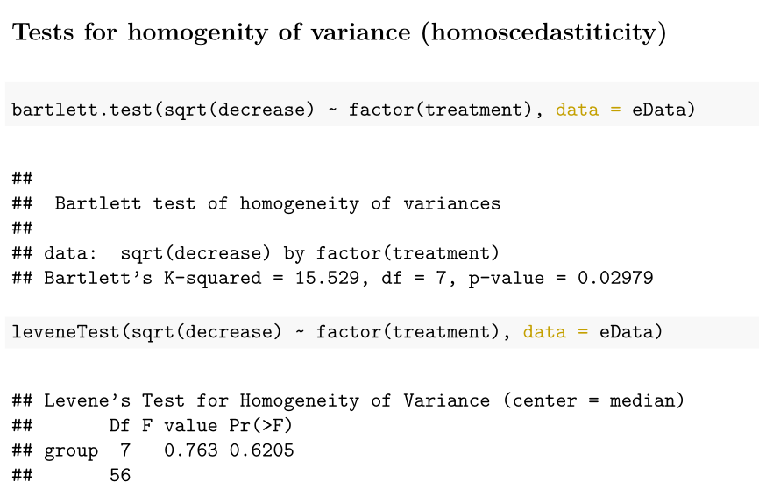
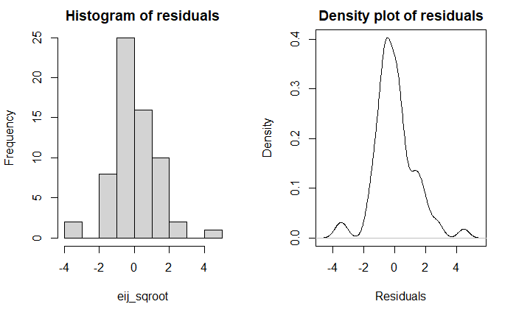
Square root transformation applied to ANOVA
FTR
Reject
FTR
Notes:
New:
We tried a square root transformation, and yet we still failed to procure a normal distribution.
Old:
Nevertheless, to minimize the influence of those residuals, let's try a square-root transformation. (In convex analysis terms, the square root transformation would apply a harsher penalty on larger outliers.)
Bartlett test rejects equality of variances, but this is suspect because it is heavily influenced by normality dist. requirement. Levene's test FTR, and is perhaps more accurate because it is more robust.
Residuals: much better.
Those gaps may be accounted for by the very small sample size (8x8=64)

Slide 13
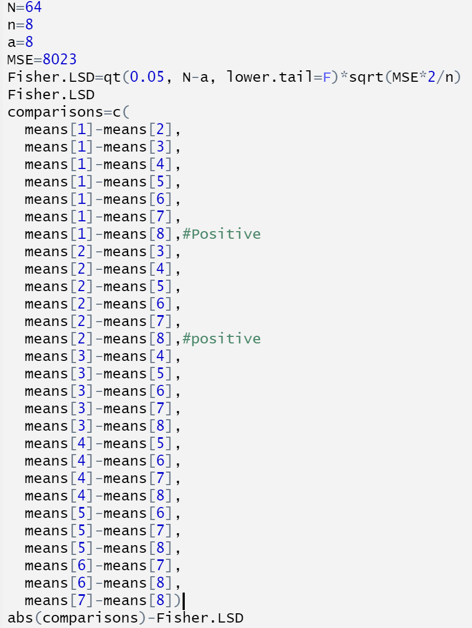
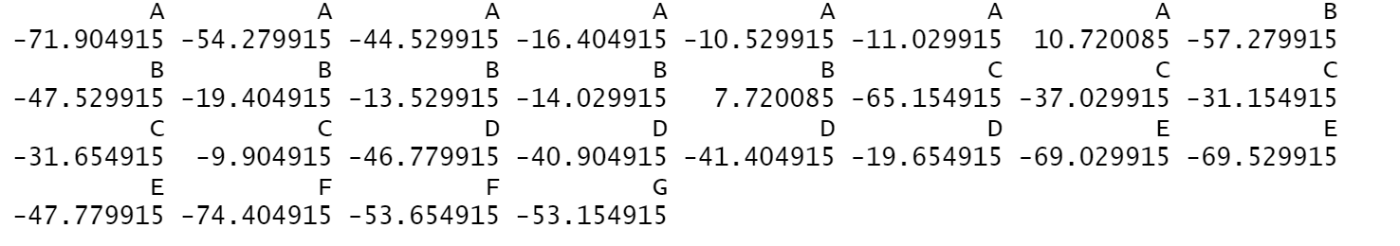
Fisher LSD Test for difference of means
Values from the difference of means for treatment groups A to H and B to H have positive values with the Fisher LSD test
Notes:
Difference in Means for A to H and B to H where H is our control group and A is our strongest concentration and B is the second strongest

Slide 14
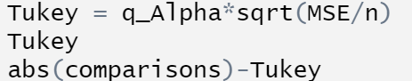
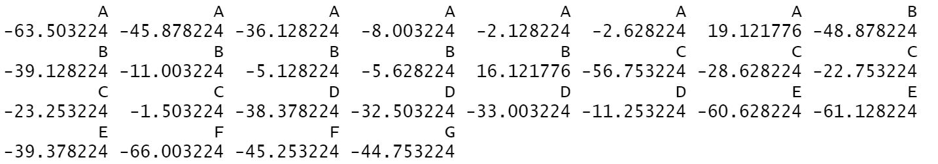
Tukey’s Test for difference of means
Tukey’s Test gives the same results as the Fisher LSD test
Notes:
Difference in Means for A to H and B to H where H is our control group

Slide 15
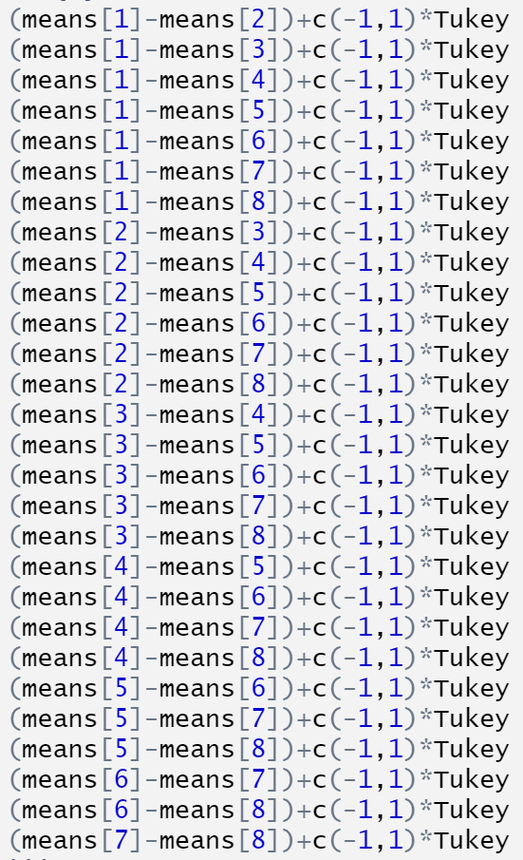
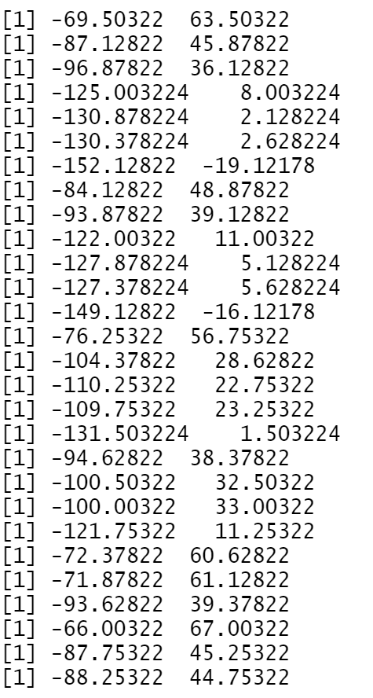
Confidence Intervals: Comparing Pairs of Treatment Means
A-H
B-H
Notes:
CI’s for difference in treatment means A to H and B to H are the only ones that don’t cross 0. This confirms our findings from the previous two tests

Slide 16

Conclusion
Accept Ha in favour of H0 (yay)
Concentration of lime sulphur used to repel honey bees will be determined by the cost of the solution, required extent of power to repel, possible environmental impacts (contamination, effect on other species, etc.)
Thank you!

Slide 17
Additional argumentation
Although homogenity of variance (homoscedasticity) appears to be present, we have little evidence to argue for normality.
However odd it may be, non-normality works in our favour: It makes sense that A and B must be outliers, which implies strong concentrations of lime sulphur solution work as honey bee repellents. Treatments C through H should see a variation, because lesser concentrations wouldn’t work as effectively. Furthermore, with 8 random cells chosen it is a natural consequence some have a greater decrease in sucrose solution than others - the honey bee’s choice of cell is random.

